Slide 1
Introduction to Bacteria
USDA NIFSI Food Safety in the Classroom©
University of Tennessee, Knoxville 2006

Slide 2
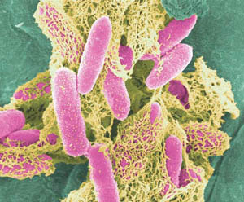
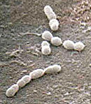
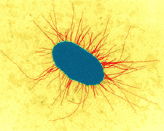
What are bacteria?
Single celled organisms
Very small
Need a microscope to see
Can be found on most materials and surfaces
Billions on and in your
body right now
E. Coli O157:H7 can make you very sick.
Streptococcus can cause strep throat.
This E. coli helps you digest food.
USDA NIFSI Food Safety in the Classroom©
University of Tennessee, Knoxville 2006

Slide 3
What do they look like?
Three basic shapes
Rod shaped called bacilli (buh-sill-eye)
Round shaped called cocci (cox-eye)
Spiral shaped
Some exist as single cells, others
cluster together
Bacilli
Cocci
Cluster of cocci
Spiral
USDA NIFSI Food Safety in the Classroom©
University of Tennessee, Knoxville 2006

Slide 4
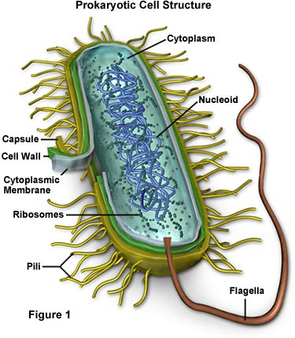
Bacteria are ALIVE!
What does it mean to be alive?
They reproduce (make more of themselves)
They need to eat
USDA NIFSI Food Safety in the Classroom©
University of Tennessee, Knoxville 2006

Slide 5
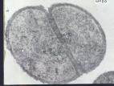
How do bacteria reproduce?
Grow in number not in size
Humans grow in size from child to adult
Make copies of themselves by dividing in half
Human parents create a child
USDA NIFSI Food Safety in the Classroom©
University of Tennessee, Knoxville 2006

Slide 6
Cellular organism copies it’s genetic information then splits into two identical daughter cells

Slide 7
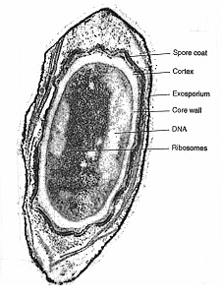
Spore Formation: Endospore
A type of dormant cell
Exhibit no signs of life
Highly resistant to environmental stresses such as:
-High temperatures
-Irradiation
-Strong acids
-Disinfectants
Endospores are formed by vegetative cells in response to environmental signals that indicate a limiting factor for vegetative growth, such as exhaustion of an essential nutrient.

Slide 8
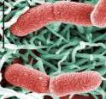
How do bacteria eat?
Some make their own food from sunlight—like plants
Some are scavengers
Share the environment around them
Example: The bacteria in your stomach are now eating what you ate for breakfast
Some are warriors (pathogens)
They attack other living things
Example: The bacteria on your face can attack skin causing infection and acne
Photosynthetic bacteria
Harmless bacteria on the stomach lining
E. Coli O157:H7
is a pathogen
USDA NIFSI Food Safety in the Classroom©
University of Tennessee, Knoxville 2006

Slide 9
What is a pathogen?
Bacteria that make you sick
Why do they make you sick?
To get food they need to survive and reproduce
How do they make you sick?
They produce poisons (toxins) that result in fever, headache, vomiting, and diarrhea and destroy body tissue
USDA NIFSI Food Safety in the Classroom©
University of Tennessee, Knoxville 2006

Slide 10
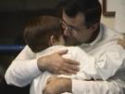
Where do you get a pathogen?
Indirect contact
Contact with people who are sick
Direct or indirect
Food, Water, or other Surfaces that are contaminated
Foods that could be contaminated
USDA NIFSI Food Safety in the Classroom©
University of Tennessee, Knoxville 2006
Direct contact

Slide 11
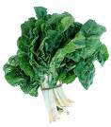
A Closer Look – Where do you get a pathogen
Direct Contact
Indirect Contact
Foods and water may be contaminated
USDA NIFSI Food Safety in the Classroom©
University of Tennessee, Knoxville 2006

Slide 12
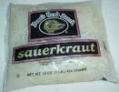
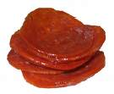
Are all bacteria pathogens?
No, most are harmless
Some are even helpful
Examples of helpful bacteria:
Lactobacillus: makes cheese, yogurt, & buttermilk and produces vitamins in your intestine
Leuconostoc: makes pickles & sauerkraut
Pediococcus: makes pepperoni, salami, & summer sausage
USDA NIFSI Food Safety in the Classroom©
University of Tennessee, Knoxville 2006

Slide 13
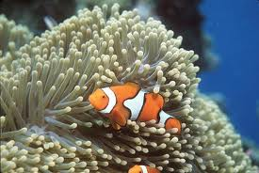
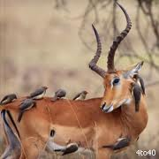
Symbiosis
Close relationship between to species in which at least one species benefits from the other
Live together for LIFE

Slide 14
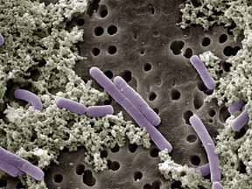
A Closer Look – Helpful Bacteria
www.bioweb.usu.edu
Pediococcus - used in production of fermented meats
Lactobacillus casei – found in human intestines and mouth to improve digestion
Leuconostoc cremoris – used in the production of buttermilk and sour cream
Lactobacillus bulgaricus – used in the production of yogurt
USDA NIFSI Food Safety in the Classroom©
University of Tennessee, Knoxville 2006

Slide 15
Mutualism
Symbiosis in which two of the species live together in such a way that both benefit from the relationship
Eg. E-coli

Slide 16
Parasitism
Bacteria exploit the host cell, injuring them
Eg. Mychobacterium tuberculosis

Slide 17
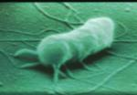
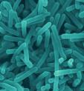
What are some common pathogens?
E. coli O157:H7
Pathogenic E. coli
(like O157:H7)
Found in ground beef, contaminated fruits and vegetables
Salmonella
Found in raw meats, poultry, eggs, sprouts, fruit and vegetables
Listeria
Found in deli foods, lunch meats, smoked fish and vegetables
Salmonella
USDA NIFSI Food Safety in the Classroom©
University of Tennessee, Knoxville 2006
Listeria

Slide 18
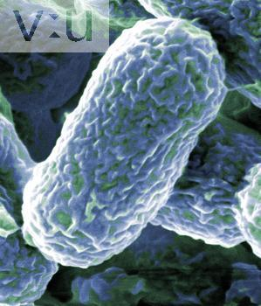
Examples of Pathogens
Salmonella
E. coli O157:H7
What shape are these bacteria? Cocci, bacilli, or spiral?
Staphylococcus aureus
Campylobacter jejuni
USDA NIFSI Food Safety in the Classroom©
University of Tennessee, Knoxville 2006

Slide 19
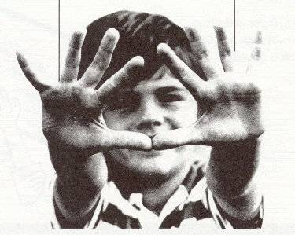
How can I avoid pathogens?
Wash your hands often so you won’t transfer bacteria to your mouth or food
Warm water with soap for 20 seconds, rub hard between fingers and nails
USDA NIFSI Food Safety in the Classroom©
University of Tennessee, Knoxville 2006

Slide 20
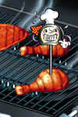
How can I avoid pathogens?
Cook food thoroughly to kill any pathogens that may be in your food
Store food properly to limit pathogen growth
Cold temperatures (40°F)
USDA NIFSI Food Safety in the Classroom©
University of Tennessee, Knoxville 2006

Slide 21
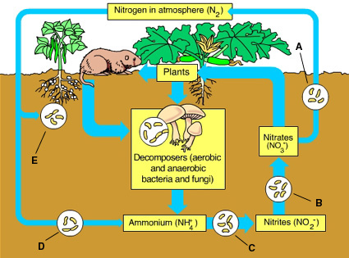
Nitrogen Fixations
Process by which nitrogen in the atmosphere is converted into a form that can be used by living things

Slide 22
Review
Bacteria are living organisms
Most are harmless
A few are pathogens that make you sick
You can reduce the risk of getting sick by washing your hands and handling food properly.
USDA NIFSI Food Safety in the Classroom©
University of Tennessee, Knoxville 2006

Slide 23
Stained Bacteria Cells at 4x

Slide 24
Stained Bacteria Cells at 10x

Slide 25
Stained Bacteria Cells at 40x

